Slide 1

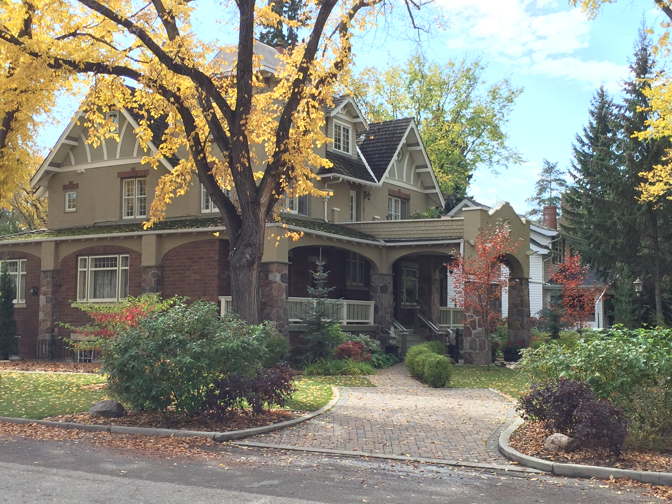

House Price Prediction
This Photo by Unknown author is licensed under CC BY.

Slide 2
Contents:
Introduction
Problem Statement
Understanding the Dataset
Tools and libraries Used
Data Preprocessing and EDA
Visualization
Model Building
Model Tuning
Finalizing Best Model
Conclusion

Slide 3
Introduction

Slide 4
Introduction
Houses are one of the necessary need of each and every person around the globe and therefore housing and real estate market is one of the markets which is one of the major contributors in the world’s economy. It is a very large market and there are various companies working in the domain.
Data science comes as a very important tool to solve problems in the domain to help the companies increase their overall revenue, profits, improving their marketing strategies and focusing on changing trends in house sales and purchases.
Predictive modelling, Market mix modelling, recommendation systems are some of the machine learning techniques used for achieving the business goals for housing companies. Our problem is related to one such housing company.

Slide 5
PROBLEM STATEMENT

Slide 6
Problem Statement
A US-based housing company named Surprise Housing has decided to enter the Australian market. The company uses data analytics to purchase houses at a price below their actual values and flip them at a higher price. For the same purpose, the company has collected a data set from the sale of houses in Australia. The data is provided in the CSV file below.
The company is looking at prospective properties to buy houses to enter the market. We are required to build a model using Machine Learning in order to predict the actual value of the prospective properties and decide whether to invest in them or not.
For this company wants to know:
Which variables are important to predict the price of variable?
How do these variables describe the price of the house?

Slide 7
Understanding the Data

Slide 8
Understanding the data
Data contains 1460 entries each having 81 variables (Split in train and test).
Data contains Null value.
Extensive EDA has to be performed to gain relationships of important variable and price.
Data contains numerical, categorical.
Features are both left or right skewed which need to be treated to remove the skewness, we've used power transformation to deal with it.
There are missing or null values which need to be treated, most of the null values are NA or 0 and the remaining values are treated with Mean or Mode.
There are certain outliers present in the dataset which need to be treated, we've used IQR method.

Slide 9
Tools and libraries used

Slide 10
Tools and libraries used
Python(Jupyter Notebook)
Numpy
Pandas
Sklearn
Matplotlib
Plotly
Seaborn
Regression Models
Ensembling Technique
GridSearch CV(HyperParaMeter Tuning)

Slide 11
Data PREPROCESSING AND EDA

Slide 12

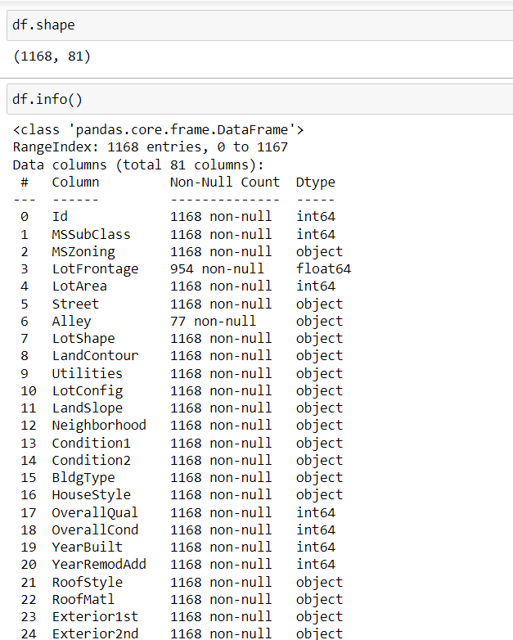
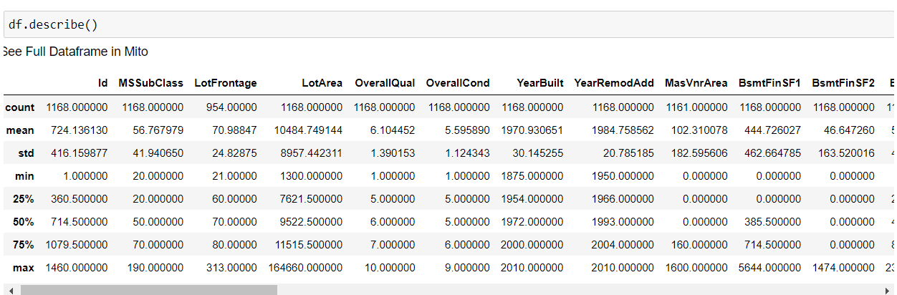
Preprocessing and eda
Loading the dataset
Having an overview of the Data and Statistical parameters

Slide 13
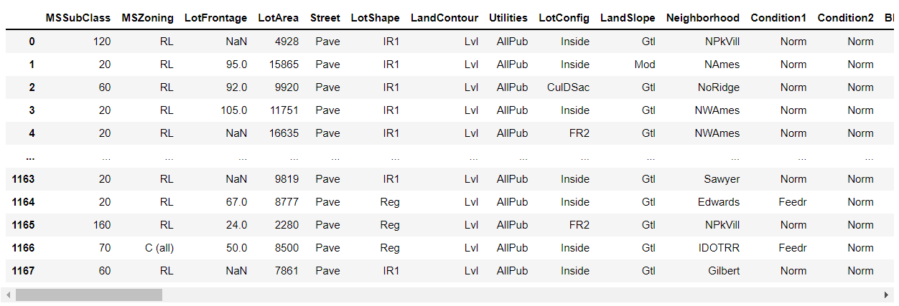
Feature Engineering
Let's start by dropping the columns that have more than 900 Null values as it would be difficult to fill such high number of null values.
We could drop Id column as well as it is not of any relevance to the model

Slide 14

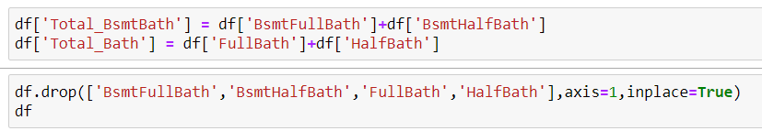

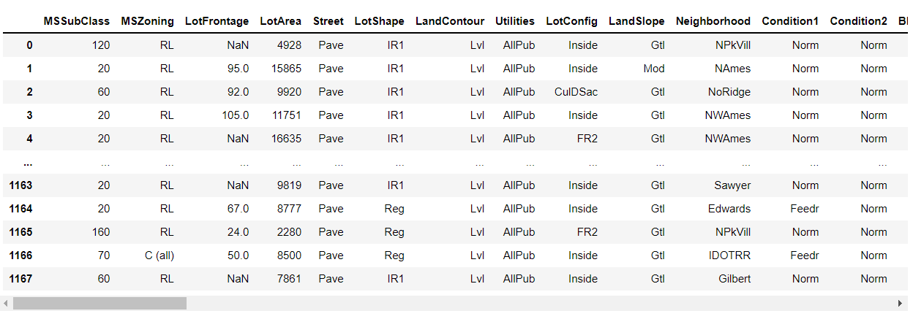
Feature Engineering
We see that we have multiple columns on bsmt : BsmtFinSF1,BsmtFinSF2 and BsmtUnfSF and we also have TotalBsmtSF which is the sum of all.We could drop multiple columns as we have a column already that sums up the same information
The same applies to BsmtFinType1,BsmtFinType2 we already have a column that depicts the basement quality.
We see we have a similar condition with bath as well, we could have 1 BsmtFullBath and 1 BsmtHalfBath with a value of 0.5 and combine it together to get total_BsmtBath.
Same applies to Full Bath and HalfBath as well.
Rather than having multiple porch, we could have total porch.

Slide 15
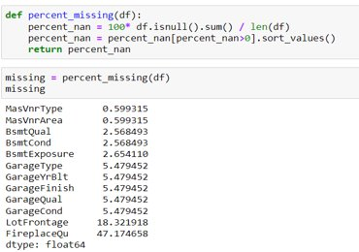
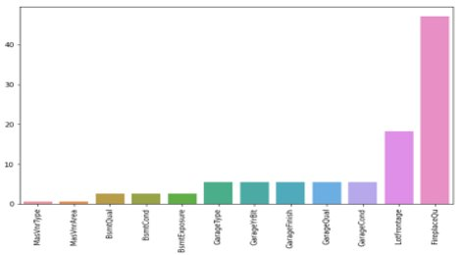
Checking Null values & Filling them
Let's check the Null values and plot them
Here after let's work on filling the Null values.

Slide 16

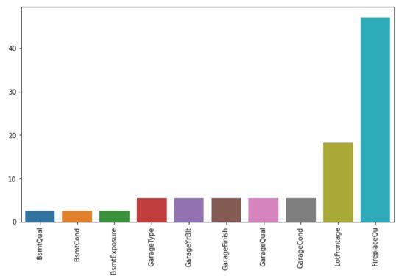
MASVNRTYPE AND MASVNRAREA null values
Let's fill null values in MasVnrType with None and MasVnrArea with mean.

Slide 17
MASVNRTYPE AND MASVNRAREA Null values
Let's fill null values in MasVnrType with None and MasVnrArea with mean.

Slide 18
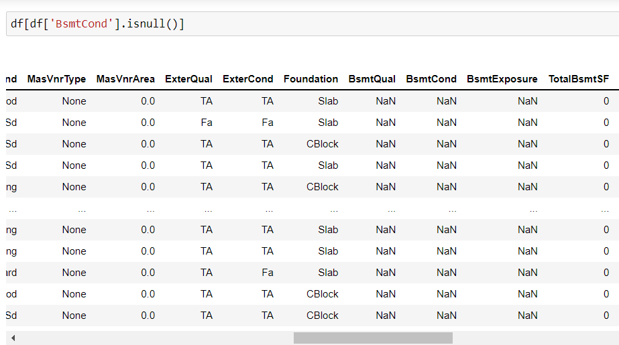

Bsmt columns null values
We see that the null columns in all the 3 Bsmt's are the once with total basement as 0 as per the documentation, looks like the NA were left as Null. Let's fill the null values with NA

Slide 19
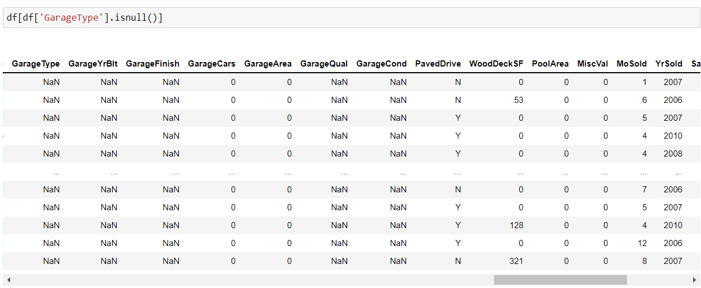
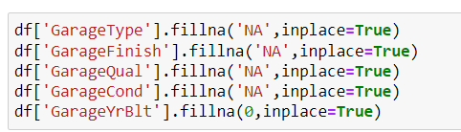
Garage Columns null values
Again we see a similar trend where in the Garage Area is 0, GarageType,GarageYrBlt, GarageFinish,GarageQual and GarageCond are left as Null. Lets fill then with the relevant fields with NA and 0

Slide 20
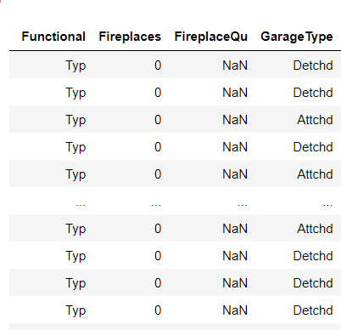

FireplaceQu null values
We see that the Null values in FireplaceQa are where the FirePlaces is 0 hence we could fill them with 'NA'

Slide 21
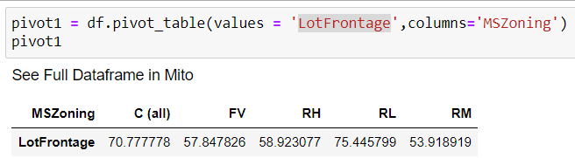
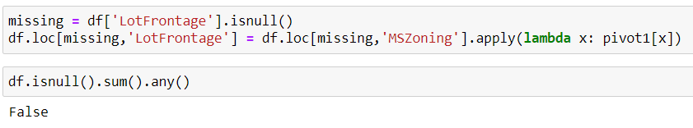
LotFrontage null values
Let's make a pivot table and check the mean values for LotFrontage based on MSZoning
Then fill the missing values based on the pivot table
Check finally if there are anymore null vales

Slide 22
Visualization

Slide 23
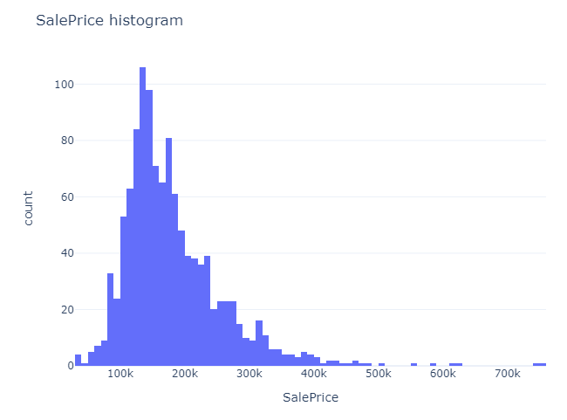
Saleprice histogram
We see that the majority of the houses sold are in the range 100-200k.

Slide 24
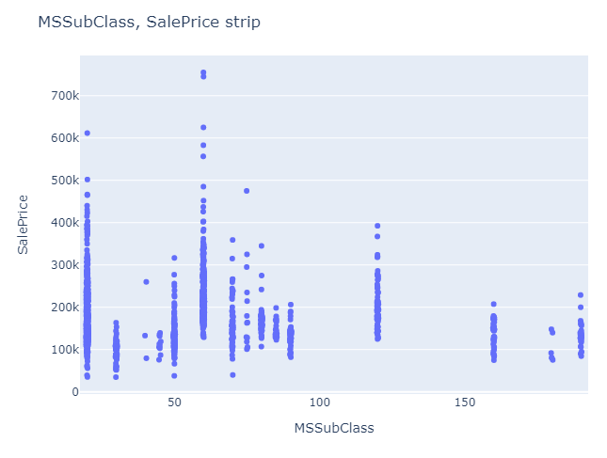
MSSubClass vs Salesprice strip plot
We see that majority of the houses sold are class 20 and class 60(1-STORY 1946 & NEWER ALL STYLES and 2-STORY 1946 & NEWER ALL STYLES)
We also see class 20 and class 60 fetch the highest prices.
class 30 1-STORY 1945 & OLDER are sold the cheapest

Slide 25
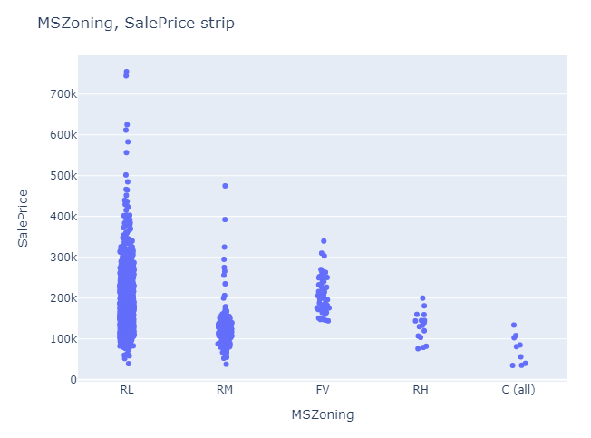
MSZoning vs saleprice
We see that the majority of the houses sold were in Residential Low density area and the least in commercial.
We also see that the prices for Residential Low Density and Floating Village Residential were on higher end.
Residential Medium Density and Commercial properties look to be on cheaper end.

Slide 26
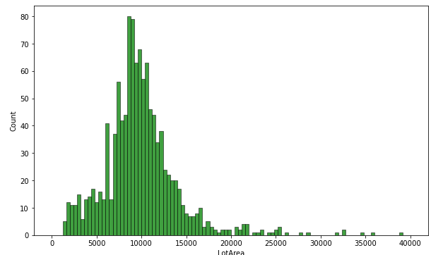
LotArea Histogram
We see majority of the properties tend to have a Lot Area between 7k to 13k

Slide 27
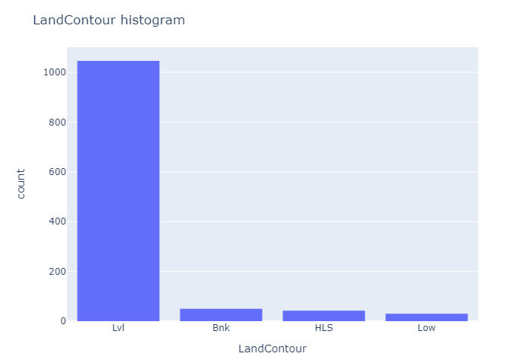
LandContour Histogram
We see the highest number of houses sold were Near Flat/Level contour.

Slide 28
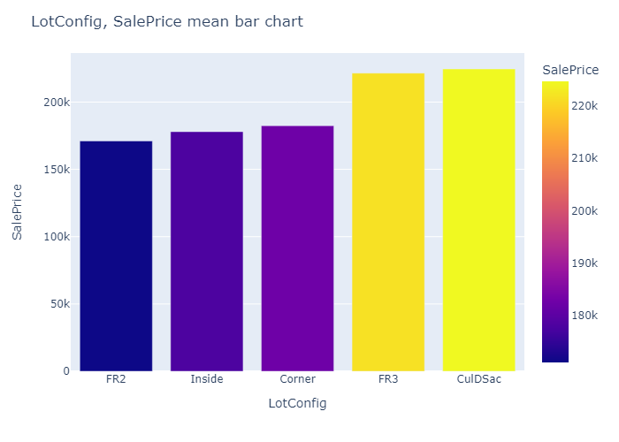
LotConfig, SalePrice mean bar chart
We see the prices for Cul d sac, the property at the end of the road has a highest average price, followed by FR3(Frontage on 3 sides of property).
FR2(Frontage on 2 sides of property) has the least average price.

Slide 29
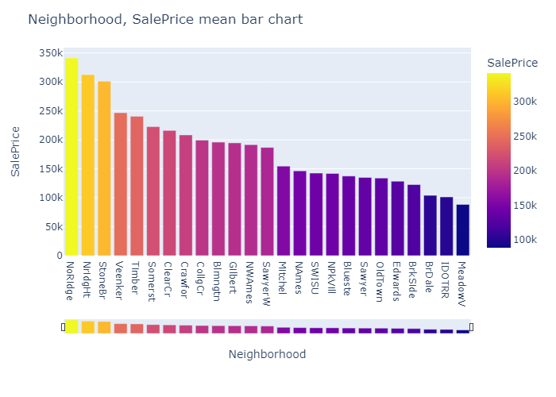
Neighborhood, SalePrice mean bar chart
Northridge followed by Northridge Heights and Stone Brook, have the highest prices.
Meadow Village and Iowa DOT and Rail Road seem to have the least prices.

Slide 30
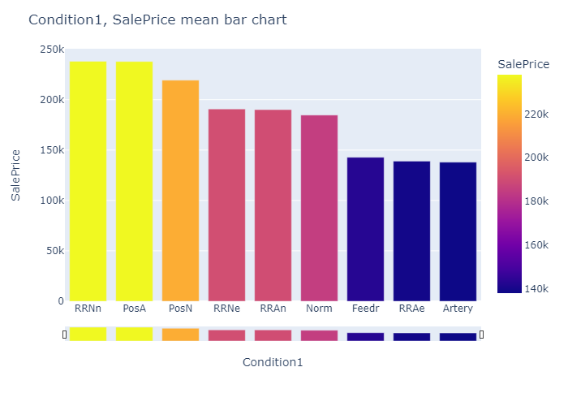
Condition1, SalePrice mean bar chart
Properties Within 200' of North-South Railroad and properties Adjacent to positive off-site feature have a the highest price.
Properties Adjacent to arterial street are cheaper.

Slide 31
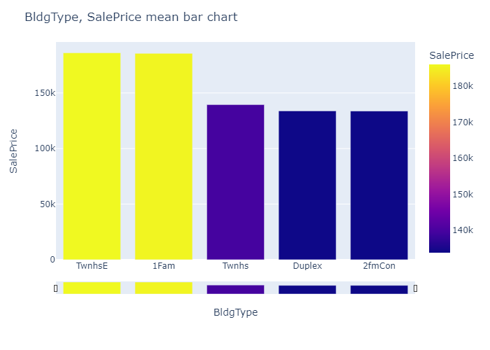
BldgType, SalePrice mean bar chart
Prices for Townhouse End Unit and Single-family Detached are Higher.
Two-family Conversion; originally built as one-family dwelling prices are the cheapest.

Slide 32
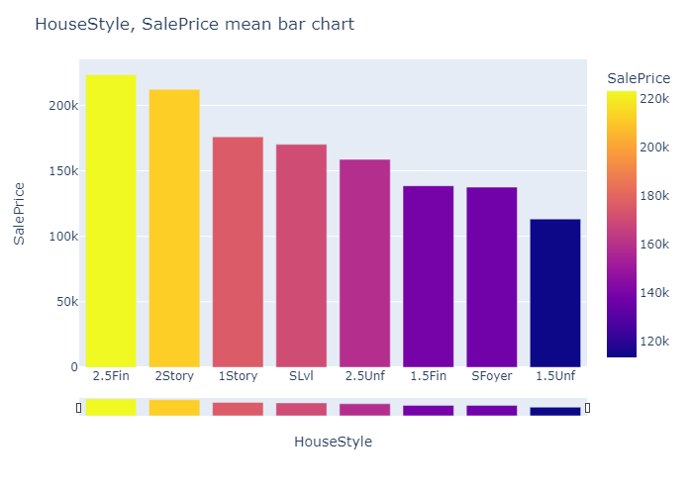
HouseStyle, SalePrice mean bar chart
Two and one-half story: 2nd level finished and Two story have the highest price.
One and one-half story: 2nd level unfinished has the lowest.

Slide 33
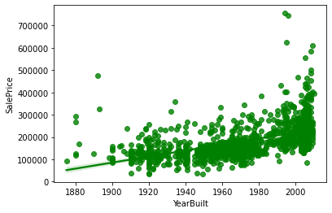
YearBuilt vs saleprice regplot
We see there is a linear relation between YearBuilt and SalePrice.
The newer the house the higher the price.

Slide 34
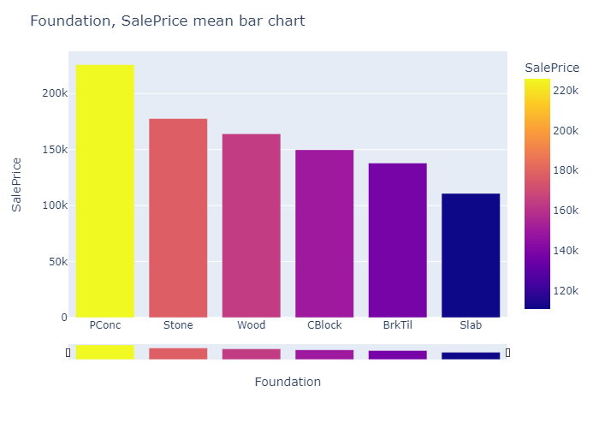
Foundation, SalePrice mean bar chart
Poured Concrete have the highest price and Slab the lowest.

Slide 35
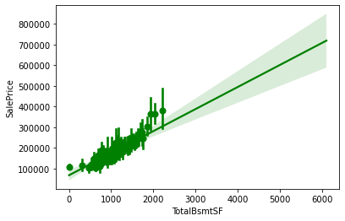
TotalBsmtSF vs Saleprice regplot
We see that as the Basement area increases, so does the price. There's a linear relation between them.

Slide 36
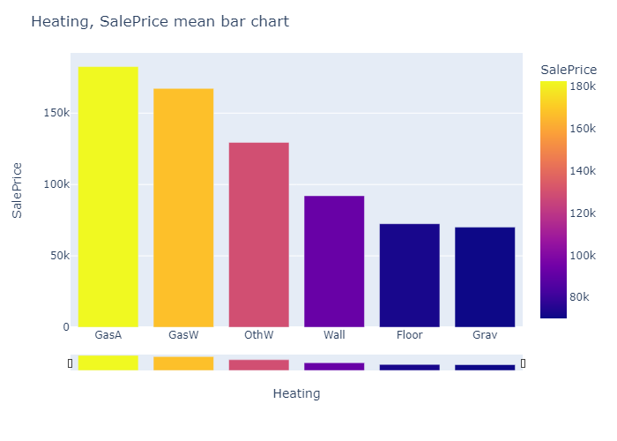
Heating, SalePrice mean bar chart
Houses powered by Gas forced warm air furnace tend to have highest price.
Homes with Gravity furnace the least.

Slide 37
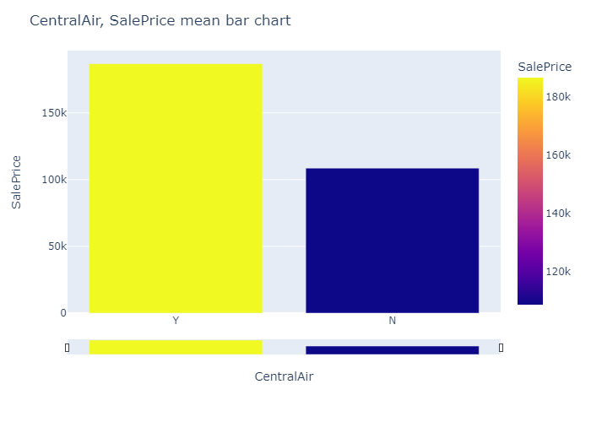
CentralAir, SalePrice mean bar chart
We see that the houses with Central Air Conditioning have a significantly higher price compare to the once without.

Slide 38
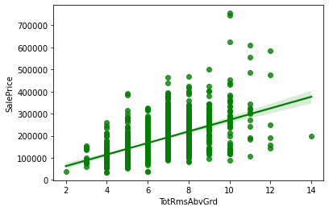
TotRmsAbvGrd vs saleprice regplot
We see there being a clear linear relationship between TotRmsAbvGrd and SalePrice.

Slide 39
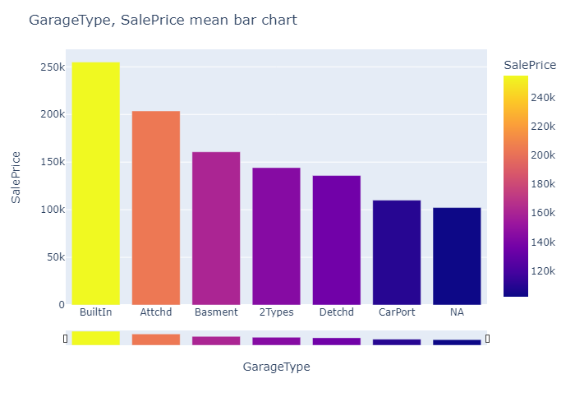
GarageType, SalePrice mean bar chart
Built-In (Garage part of house - typically has room above garage) Garage tend to fetch the highest price and Car Port the lowest.

Slide 40
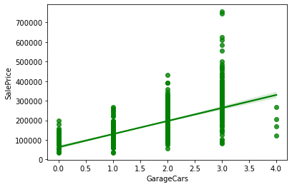
GarageCars vs saleprice regplot
We see as the number of car parkings increase, so does the price.

Slide 41
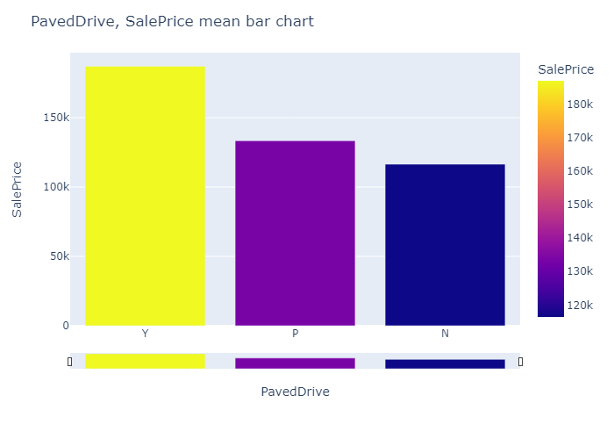
PavedDrive, SalePrice mean bar chart
We see the houses with Paved drive have a higher price than those without it.

Slide 42
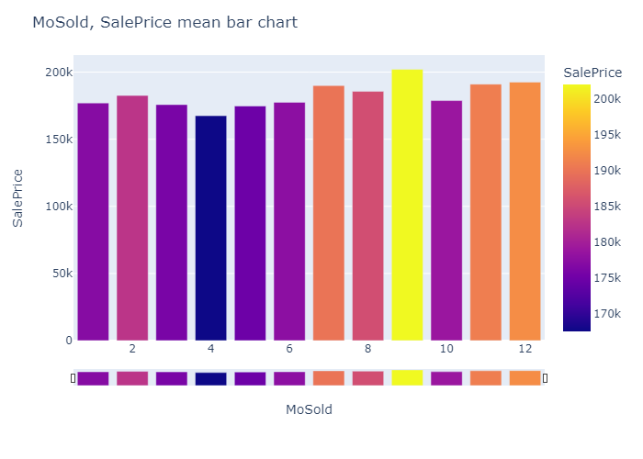
MoSold, SalePrice mean bar chart
We see the houses sold in the month of September tend to have Higher Price and the houses sold in April lower prices.
We also see the houses sold in first 6 months of the year have in general lower price than the once sold in last 6.

Slide 43
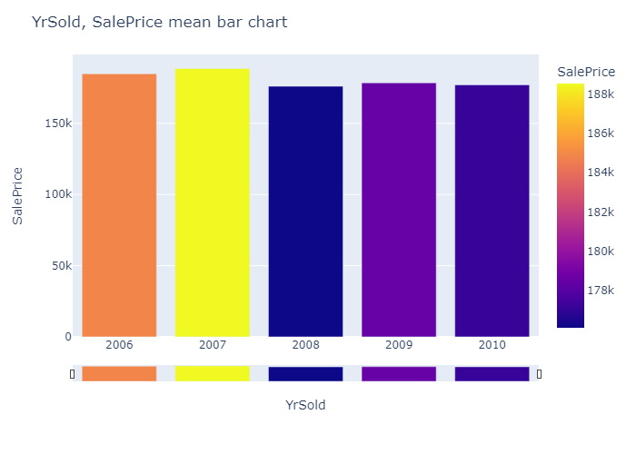
YrSold, SalePrice mean bar chart
We see that the prices for the houses were the lowest in 2008 the major reason being global financial crisis (GFC)

Slide 44
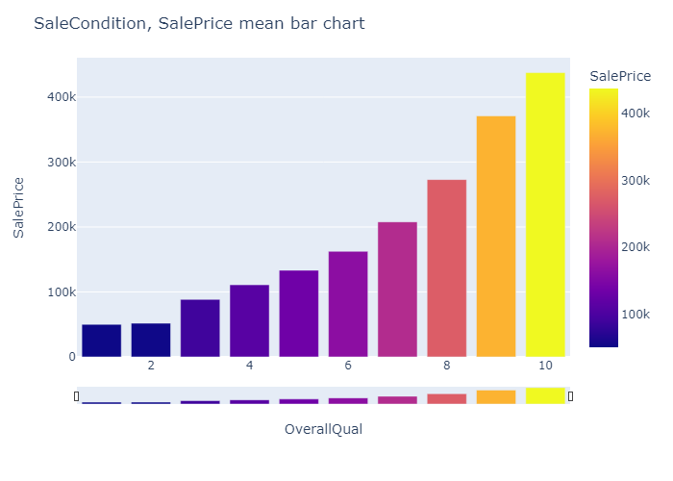
SaleCondition, SalePrice mean bar chart
We see that as the overall quality increases, so does the Price.

Slide 45
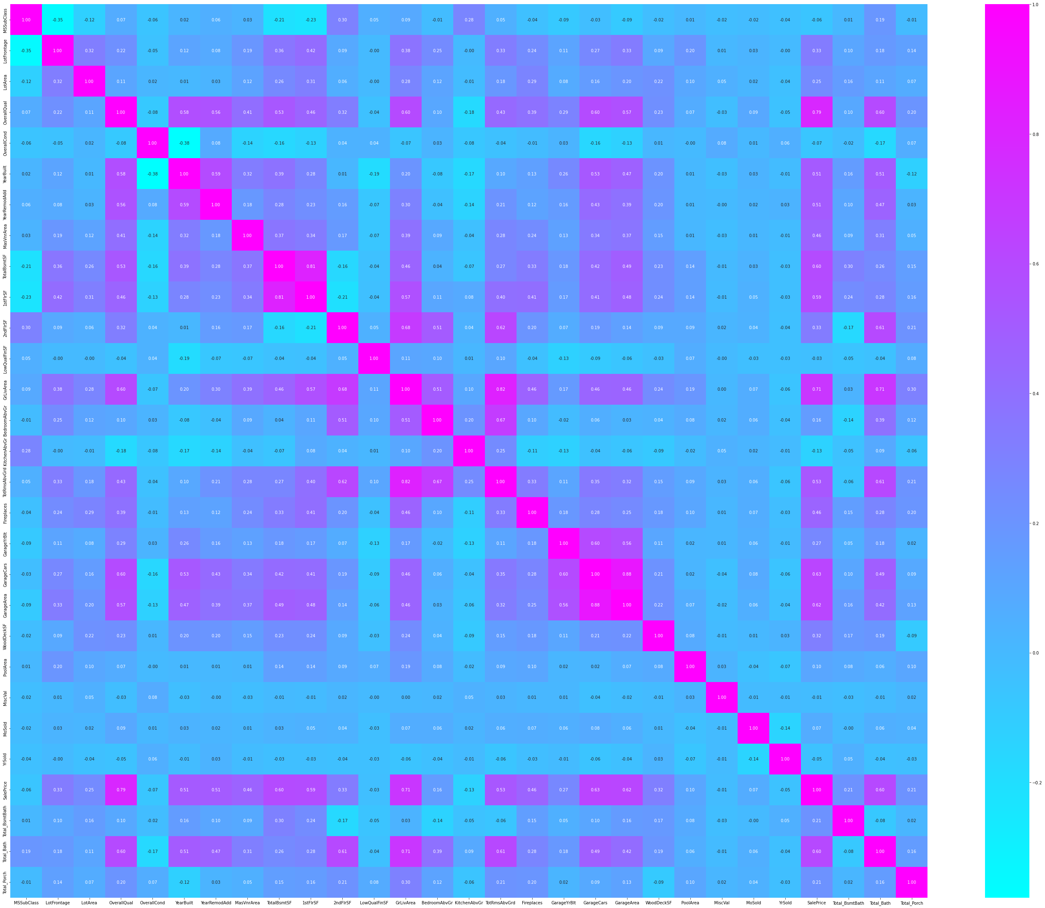
Checking Correlations
We see tha the features have both +ve and -ve correlation with the Target variable.
Weakest Correlation
OverallCond -0.065642
YrSold -0.045508
LowQualFinSF -0.032381
MiscVal -0.013071
MoSold 0.072764
Strongest Correlation
GrLivArea 0.707300
OverallQual 0.789185

Slide 46
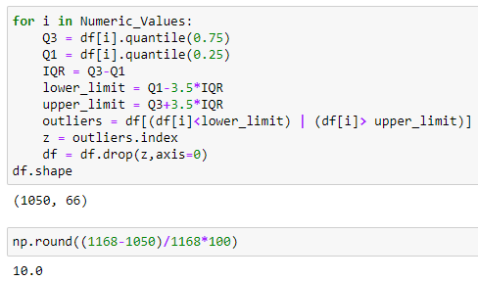
Removing Outliers

Slide 47
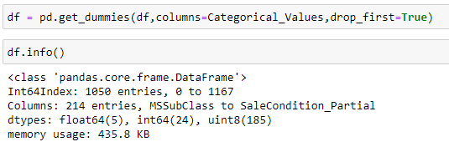
Encoding Categorical Variables

Slide 48
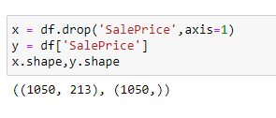
SPLITTING THE DATASET INTO TARGET AND FEATURES

Slide 49
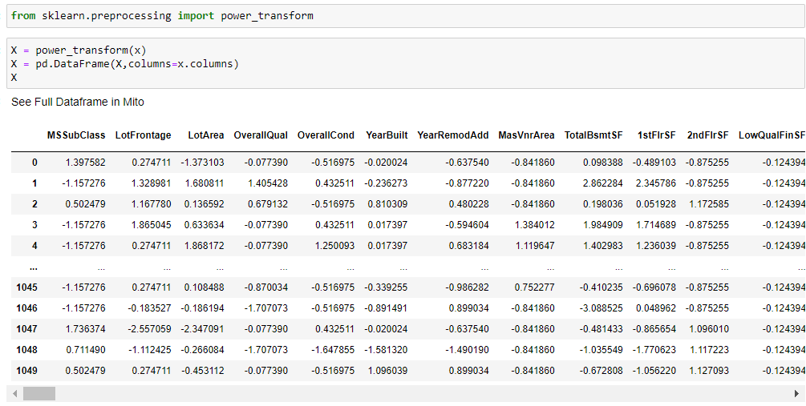
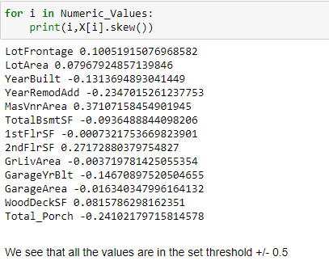
Removing Skewness
We use power_transform to remove the skewness.
Checking the skewness after power_transform is with in the set threshold.

Slide 50
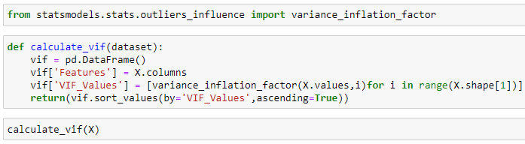
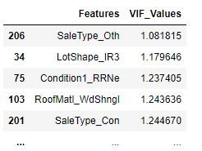
Checking Vif
We see the VIF is within the set threshold 5.

Slide 51
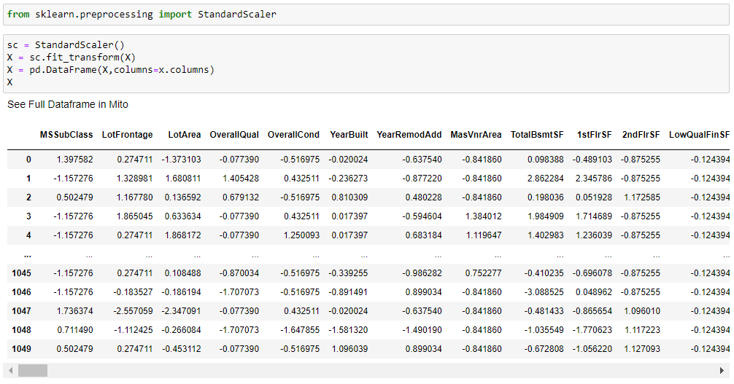
Scaling the data

Slide 52
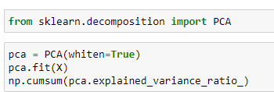
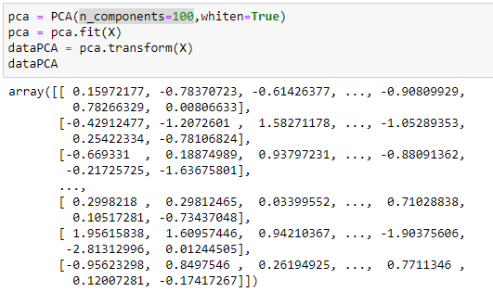
PCA
We set a threshold of 99%, which is achieved at n_components=100.

Slide 53
Model building

Slide 54
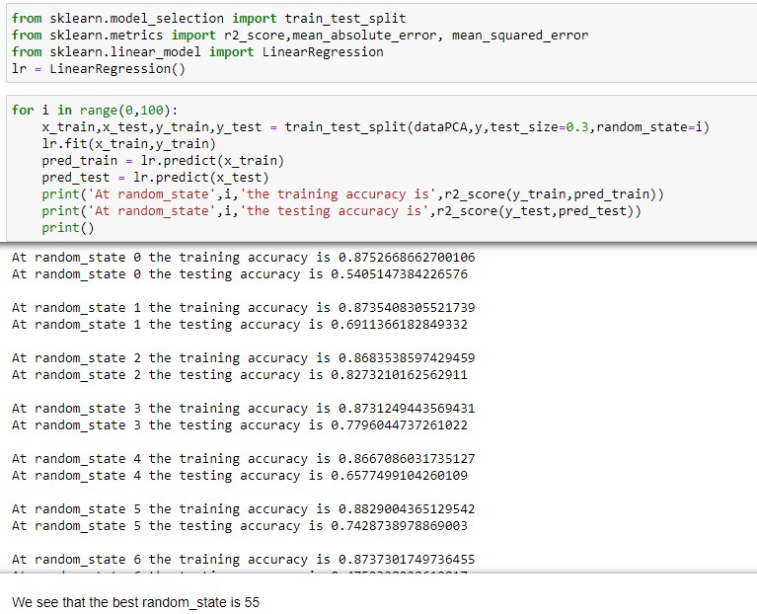
FINDING THE BEST RANDOM_STATE

Slide 55
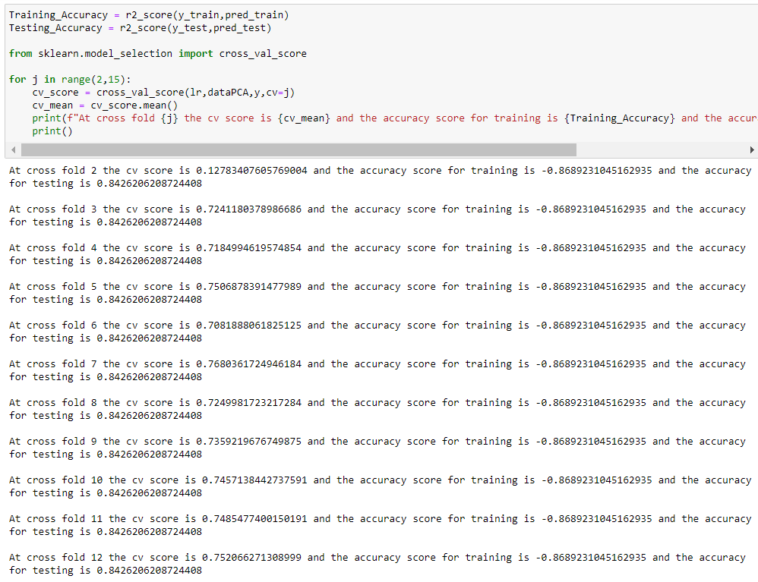
Finding the optimal cross-folds for best cross validation score

Slide 56

Defining the model to be tested on various algorithms

Slide 57
Performance of various Regression Based Models
Linear Regression
MSE 816256678.8115723 Mean Absolute Error 20681.4116021397 r2_score 84.26206208724409 CV 76.80361724946184 Difference between r2_score and cv is 7.4584448377822525
Ridge
MSE 816385236.1903766 Mean Absolute Error 20681.4116021397 r2_score 84.26206208724409 CV 77.07961714635309 Difference between r2_score and cv is 7.182444940891003
Lasso
MSE 816054513.5916703 Mean Absolute Error 20681.4116021397 r2_score 84.26206208724409 CV 76.84376496196742 Difference between r2_score and cv is 7.418297125276666
ElasticNet
MSE 1549183911.8860266 Mean Absolute Error 20681.4116021397 r2_score 84.26206208724409 CV 72.23397294570952 Difference between r2_score and cv is 12.028089141534565

Slide 58
Performance of Tree based Models/ Ensemble Models
DecisionTreeRegressor
MSE 2513132078.2095237 Mean Absolute Error 20681.4116021397 r2_score 84.26206208724409 CV 54.413889016532565 Difference between r2_score and cv is 29.848173070711525
ExtraTreesRegressor
MSE 1016430748.5230589 Mean Absolute Error 20681.4116021397 r2_score 84.26206208724409 CV 82.51635948164918 Difference between r2_score and cv is 1.7457026055949143
RandomForestRegressor
MSE 1117211661.8226366 Mean Absolute Error 20681.4116021397 r2_score 84.26206208724409 CV 80.24362322661895 Difference between r2_score and cv is 4.018438860625139
GradientBoostingRegressor
MSE 960324585.3935404 Mean Absolute Error 20681.4116021397 r2_score 84.26206208724409 CV 81.52593182521369 Difference between r2_score and cv is 2.7361302620304

Slide 59
Hyperparameter tuning

Slide 60

RandomForestRegressor

Slide 61

ExtraTreesRegressor

Slide 62

GradientBoostingRegressor

Slide 63

Final Model: ExtraTreesRegressor with HyperParameter Tunning

Slide 64

Saving the Model

Slide 65

Checking the results for test data

Slide 66
Thanks

